Slide 1
PREDICTING HEART DISEASE USING MACHINE LEARNING ALGORITHM
SUBMITTED BY :
NATHAN V (311619205022)
SANTHOSHKUMAR D (311619205022)
SATYAM KUMAR (311619205023)
GUIDE :
Mrs.R.THENMOZHI
ASSISTANT PROFESSOR/IT
MNMJEC

Slide 2
ABSTRACT
There are various classification methods are applied to predict different diseases, such as heart disease, diabetes, tuberculosis, and so on, in various fields. In this project we are decided to use Machine Learning Algorithm to predict the accuracy level of heart disease.The disease can be predicted by obtaining the accuracy obtained by the various algorithms such as Support Vector Machine, K-Nearest Neighbor, Decision Tree, and Random forest.There are 14 different laboratory parameters of the patients are used as the dataset.Accuracy score and confusion matrix is used to compare this classification algorithm.

Slide 3
INTRODUCTION
We already know that Machine learning can easily learnes from experience using algorithm to make predictions.
To improve the accuracy and performance of the heart disease prediction using linear regression model.
Heart disease can be predicted by checking the level of cp, trestbps, chol, fbs, restecg, thalach, exang, oldpeak, slope, ca, thal .
Then spilt the datasets as 67% and 33% for training them before into classification.
They can classified using Decision Tree, K nearest neighbor, Random Forest, Support Vector Machine algorithm to find the accuracy value.

Slide 4
OBJECTIVE
For this research paper, the main aim is to predict heart disease using a classification algorithm.
In recent years, heart disease has increased rapidly and it is considered to be a very fatal disease in many countries.
Increased accuracy level and time complexity.
we can collected the original datasets value of the patients for prediction .

Slide 5
SCOPE
Machine learning enables a machine to automatically learn from data, improve performance from experiences, and predict things without being explicitly programmed.
Machine learning algorithms build a mathematical model of sample data, known as “ training data ”.
In our projects it were used on ,
Data collection
Data Preprocessing
Supervised Learning Algorithms
Evaluation & Deployment

Slide 6
LITERATURE SURVEY
S. No | Article | Inferences | Year
1 | D. Sisodia and D. S. Sisodia, "Prediction of diabetes using classification algorithms" | Using Descision tree & principal component analysis (PCA) . | 2018
2 | H. Roopa and T. Asha, "Feature extraction of chest X-ray images and analysis using PCA and kPCA" | Analysis using x-ray image (with 14 parameters ) | 2018
3 | R. Bansal, S. Kumar and A. Mahajan, "Diagnosis of diabetes mellitus sing PSO and KNN classifier" | PSO and KNN are the two used to get accuracy level. | 2017

Slide 7
LITERATURE SURVEY (contd..)
S. No | Article | Inferences | Year
4 | Manjeevan Seera and Chee Peng Lim, "A hybrid intelligent system for medical data classification" | Neural Networks and Random Forests | 2014
5 | K. Polat, S. Güneş and A. Arslan, "A cascade learning system for classification of diabetes disease | Analysis and least square support vector machine(SVM) | 2008

Slide 8
EXISTING SYSTEM
Various classification methods are applied to predict different diseases, such as diabetes, tuberculosis and so on, in the medical field.
Extracted features of CVD data in the existing system are projected to a new space using principal component analysis.
In the existing system, the Cardiovascular disease can be analyzed by checking the level patiets .

Slide 9
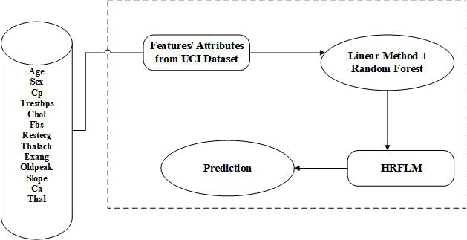
EXISTING SYSTEM(contd..)
System Architecture :

Slide 10
EXISTING SYSTEM (contd..)
DRAWBACKS :
Low performance computing.
The classification accuracy and time complexity should be improved.
Missing values, noisy data, inconsistencies and outliers presented a challenge in this process.

Slide 11
PROPOSED SYSTEM
To improve the accuracy and performance of the heart disease prediction using linear based model.
The main aim is to predict heart disease using a classification algorithm.
Need to find out accuracy and then used to compare this classification algorithm.

Slide 12
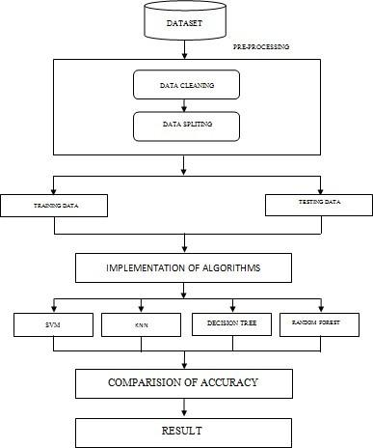
SYSTEM ARCHITECTURE :

Slide 13
PROPOSED SYSTEM (contd..)
SYSTEM REQUIREMENTS :
ANACONDA NAVIGATOR
JUPYTER NOTEBOOK
LIBRARIES USED :
KERAS
PANDAS
NUMPY
SCIKIT LEARN
SEABORN

Slide 14
PROPOSED SYSTEM (contd..)
Modules :
The proposed system consists of some modules such as ,
Data collection
Data Preprocessing
Supervised Learning Algorithms
Evaluation & Deployment

Slide 15
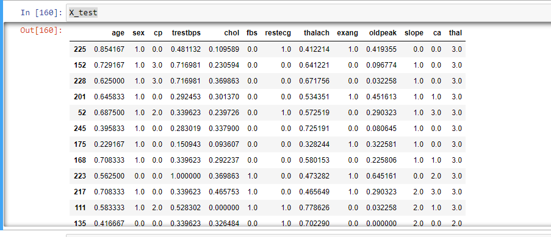
PROPOSED SYSTEM
COLLECTING & IMPORT DATA :
Step 1: Import Libraries.
Step 2: Import the Dataset.
Step 3: Taking care of Missing Data in Dataset.

Slide 16
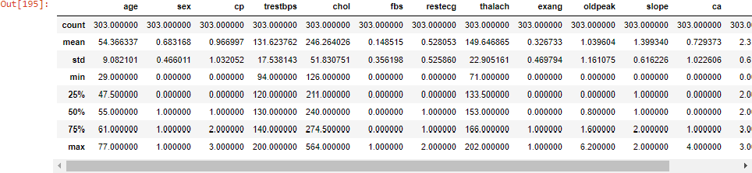
DESCRIBE DATASET

Slide 17
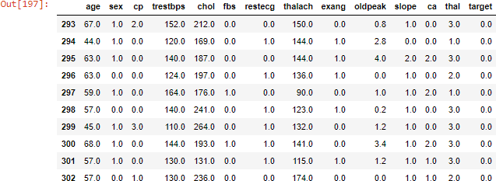
Module 2- DATA PRE-PROCESSING
DATA PREPROCESSING :
Step 4: Encoding categorical data.
Step 5: Splitting the Dataset into Training set and Test Set.
Step 6: Feature Scaling.

Slide 18
ALGORITHMS USED - Module 2
The supervised Learning Algorithms used in this project is ,
Support Vector Machine(SVM)
K-Nearest Neighbor
Decision Tree
Random Forest

Slide 19
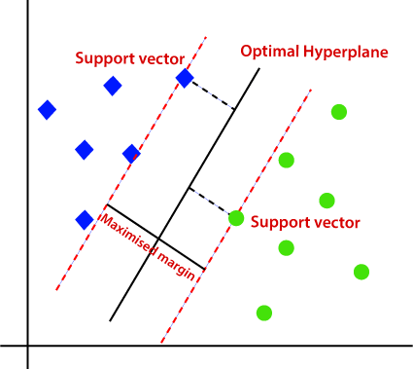
SUPPORT VECTOR MACHINE
SVM maps the input data to high dimensional feature space through kernels, so that it can be separated by a hyperplane.
It has two suppoerting terms to describe the plane .

Slide 20
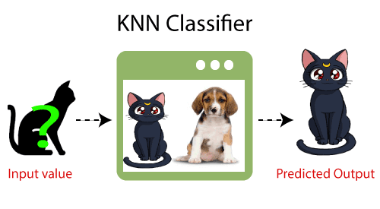
K-NEAREST NEIGHBOUR
KNN algorithm at the training phase just stores the dataset and when it gets new data, then it classifies that data into a category that is much similar to the new data.

Slide 21
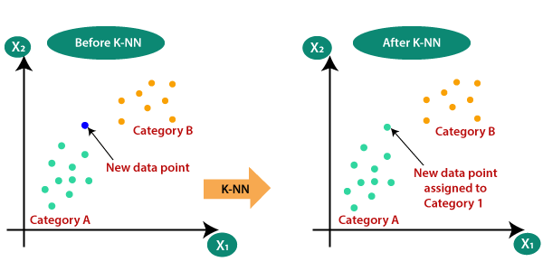
KNN FORMULA
KNN use the Euclidean formula for calculate the two values between X1 & X2 by ,

Slide 22

DECISION TREE
Similar to a tree, it starts with the root node, which expands on further branches and constructs a tree-like structure.
Mainly used Entropy formula for calculations.

Slide 23
RANDOM FOREST
Step-1: Select random K data points from the training set.
Step-2: Build the decision trees associated with the selected data points (Subsets).
Step-3: Choose the number N for decision trees that you want to build.
Step-4: Repeat Step 1 & 2.
Step-5: For new data points, find the predictions of each decision tree, and assign the new data points to the category that wins the majority votes.

Slide 24
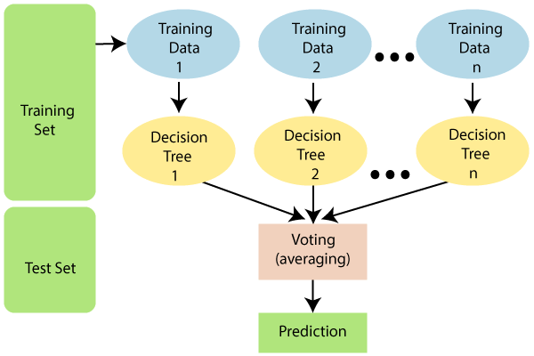
RANDOM FOREST

Slide 25
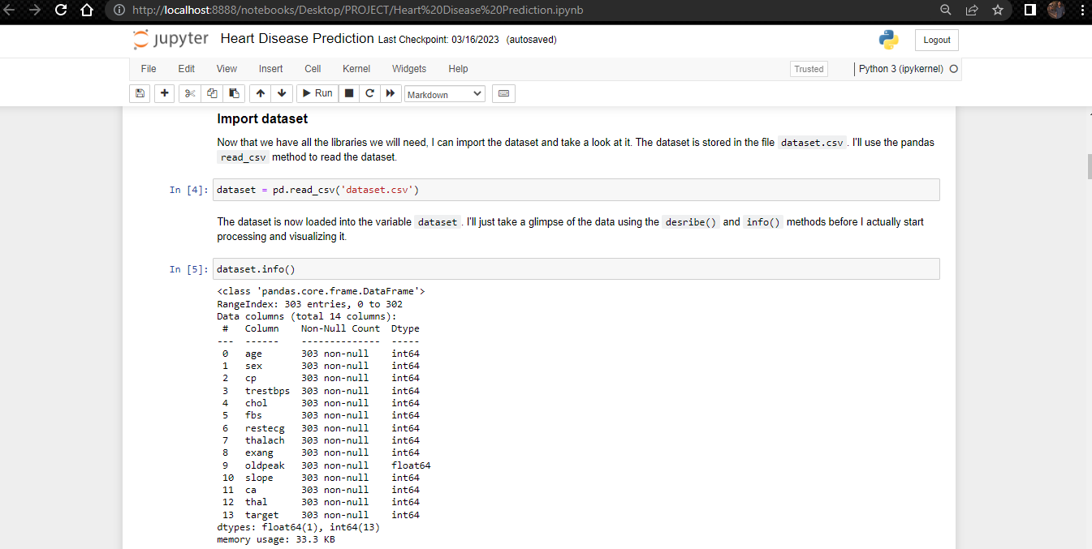
EXECUTION
Insert CSV file as INPUT :

Slide 26
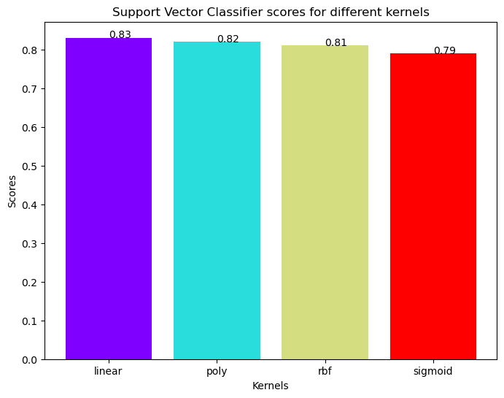
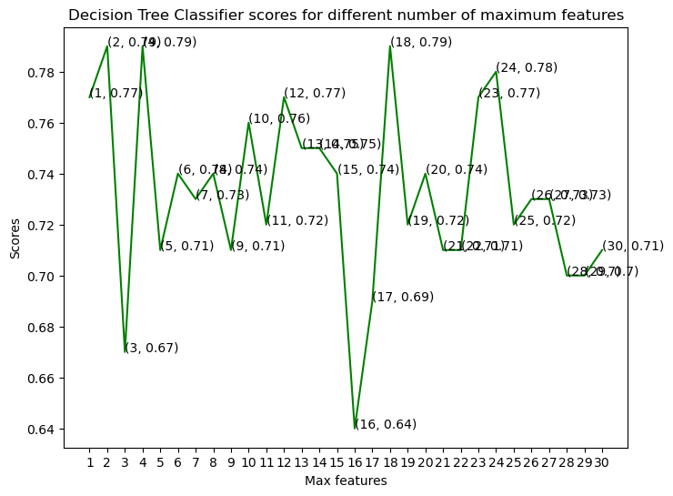
DEPLOYMENT (SCREENSHOTS)

Slide 27
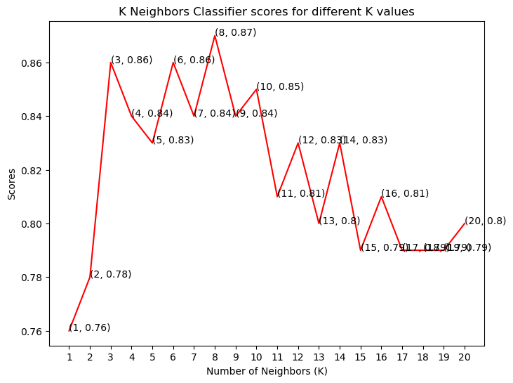
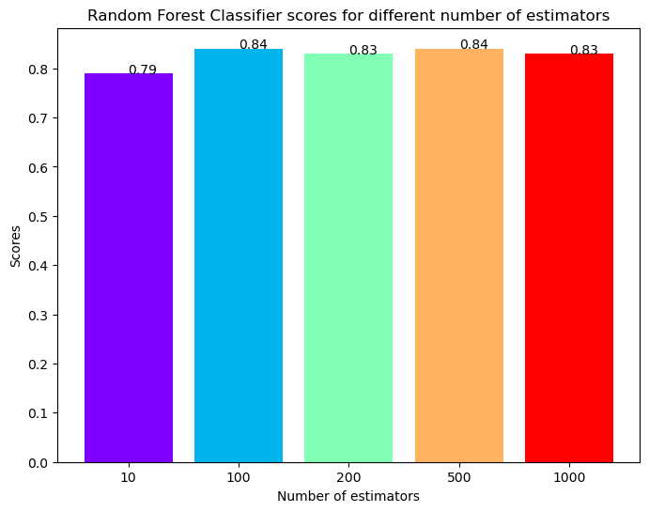
DEPLOYMENT (SCREENSHOTS)

Slide 28
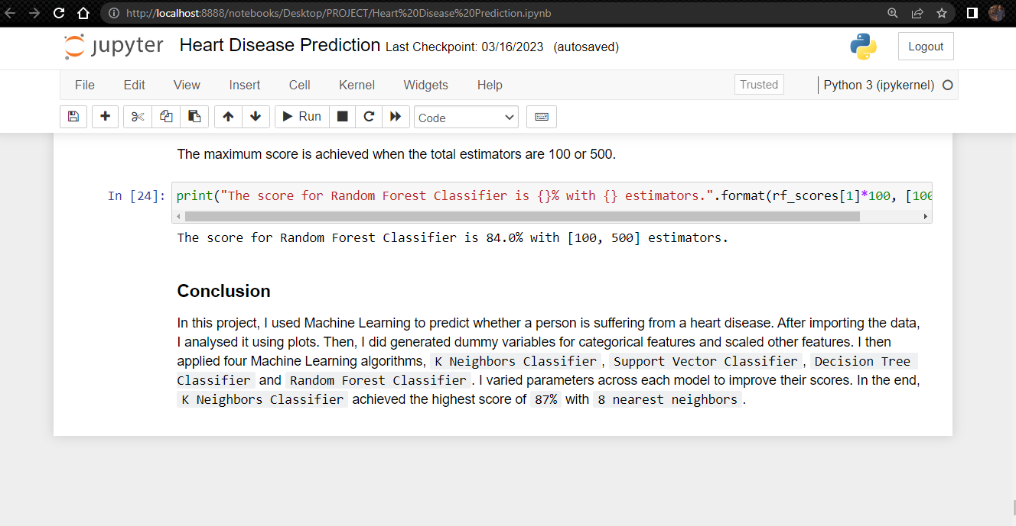
OUTPUT
The KNN Algorithm has occurs 87 % accuracy and also highest accuracy then other algorithms.

Slide 29
COMPARATIVE RESULTS
S. No | Existing System | Proposed System | Properties
1 | HRFLM & RF | RF , SVM, DT, KNN | Best Algorithm
2 | 82.7 % | 87 % | Accuracy Value
3 | They use only for Cardiovascular disease. | we used for common heart disease. | Difference between disease

Slide 30
PERFORMANCE ANALYSIS
ALGORITHM | ACCURACY LEVEL
K-Nearest Neighbour | 87 %
Suppoert Vector Machine | 83 %
Decision Tree | 79 %
Random Forest | 84 %

Slide 31
PERFORMANCE ANALYSIS
From the above result and analysis the K-Nearest Neighbours is occurs the highest level of accuracy compare to other given algorithms.
It occurs 87 % of accuracy level ,the patients are having heart disease by obtained datasets.

Slide 32
CONCLUSION
The best accuracy will find out by applying the datasets into all the 4 different algorithms.
These method is used to find quicks then others.
In Future these algorithms are used to predict various other diseases such as diabetes, liver disease by adding remaining algorithms.

Slide 33
REFERENCE PAPERS
[1] D. Sisodia and D. S. Sisodia, "Prediction of diabetes using classification algorithms", Procedia Comput. Sci., vol. 132, pp. 1578-1585, Jan. 2018.
[2] H. Roopa and T. Asha, "Analysis of feature ranking methods on X-ray images", Proc. Int. Conf. ISMAC Comput. Vis. Bio-Eng., pp. 1393-1403, 2018.
[3] R. Bansal, S. Kumar and A. Mahajan, "Diagnosis of diabetes mellitus using PSO and KNN classifier", Proc. Int. Conf. Comput. Commun. Technol. Smart Nation (IC3TSN), pp. 32-38, Oct. 2017.
[4] K. Polat, S. Güneş and A. Arslan, "A cascade learning system for classification of diabetes disease: Generalized discriminant analysis and least square support vector machine", Expert Syst. Appl., vol. 34, pp. 482- 487, 2008.
[5] M. Seera and C. P. Lim, "A hybrid intelligent system for medical data classification", Expert Syst. Appl., vol. 41, no. 5, pp. 2239-2249, 2014.

Slide 34
THANK YOU

